Slide 1
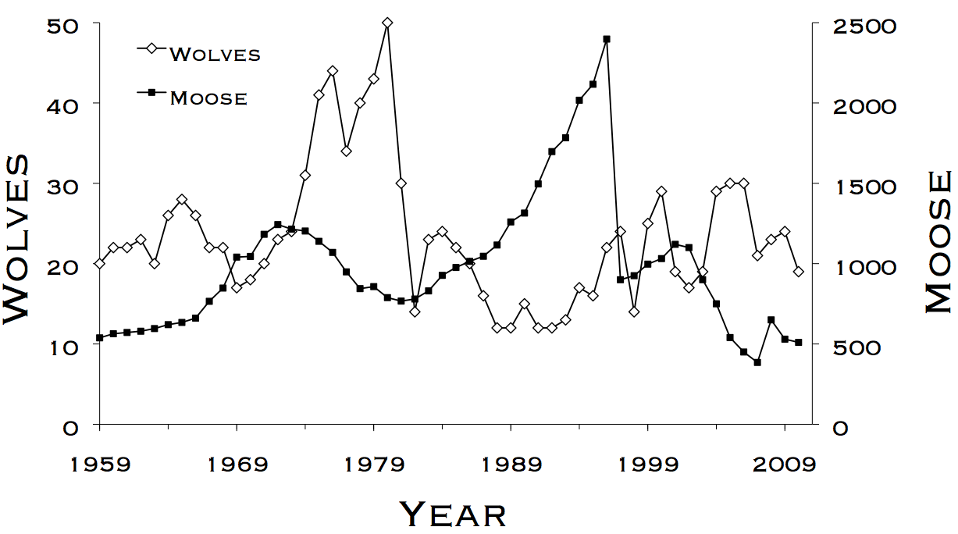
Lab 2 – Exponential and Logistic Growth
WLE 411, Week 5

Slide 2
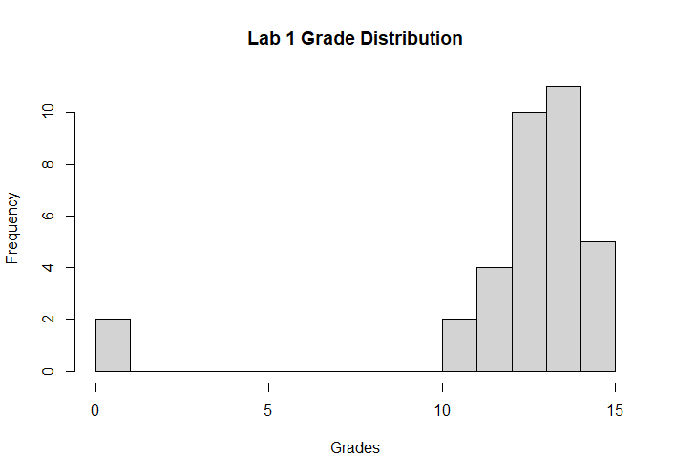
Notes:
mean: ~85%
median: ~87%
sd: ~10%
min: ~53% (person who hasn't submitted the word doc yet, haven't released their grade yet)
max: 100% (one perfect score)
From the empirical distribution:
Got less than a C (<70): 9%
Got less than a B( <80): 21%
Got less than an A (<90): 70%
The basic issues that came up were graph formatting, not reading the lab (they would forget to add a specific part to a question), and having values for the graph not linked to calculations.

Slide 3
Year | λ
1 | 1.12
2 | 1.535714
3 | 1.581395
4 | 1.397059
5 | 0.978947
6 | 1.107527
7 | 1.533981
8 | 1.075949
9 | 1.6
10 | 1.327206
11 | 1.091413
12 | 1.532995
13 | 1.508278
14 | 1.299671
15 | 1.559966
Notes:
Lambda is never just one number

Slide 4
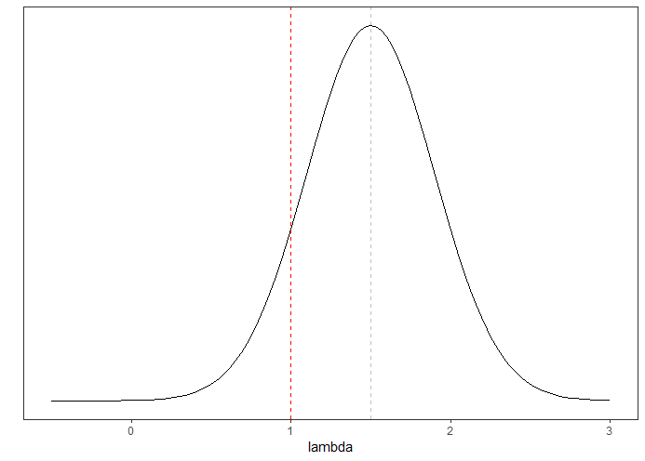
Mean λ can be positive,
but still result in bad years
Notes:
Distribution of lambda
If lambda falls below 1 too often, the population can go extinct,
This can happen by chance, even if mean lambda is above 1

Slide 5
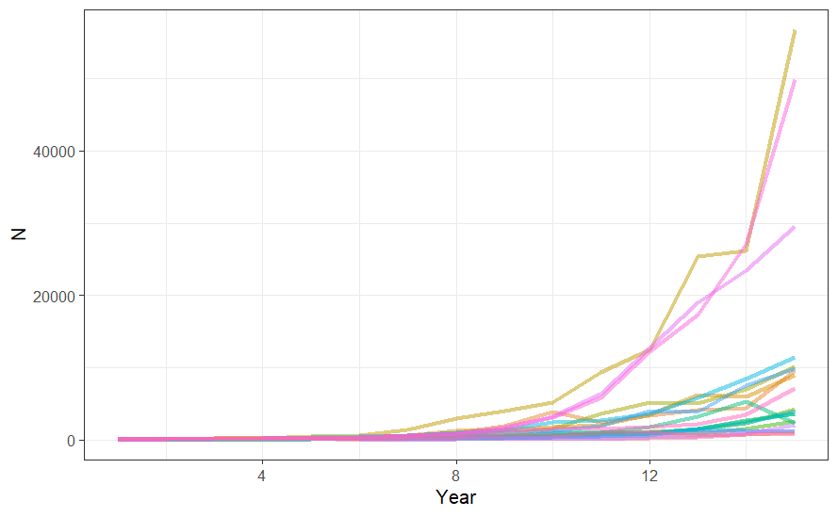
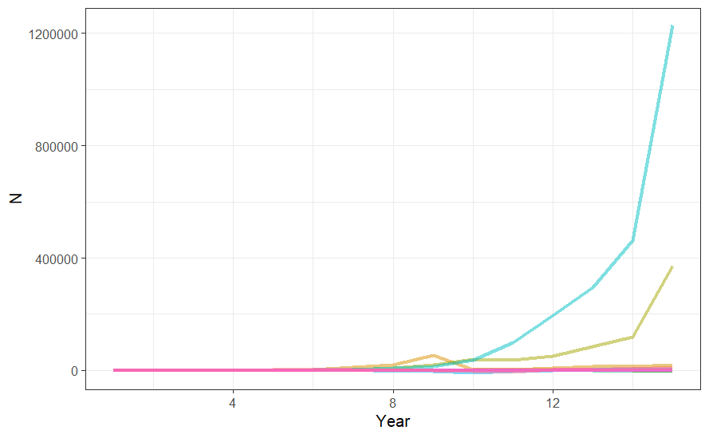
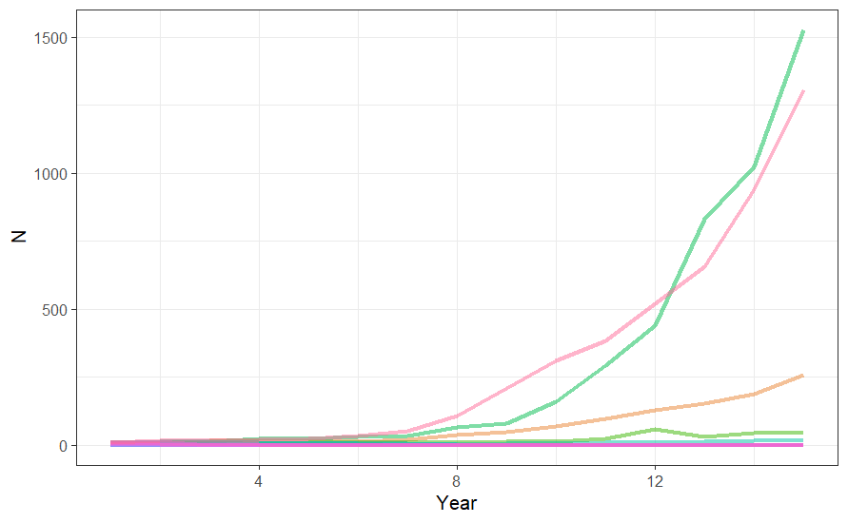
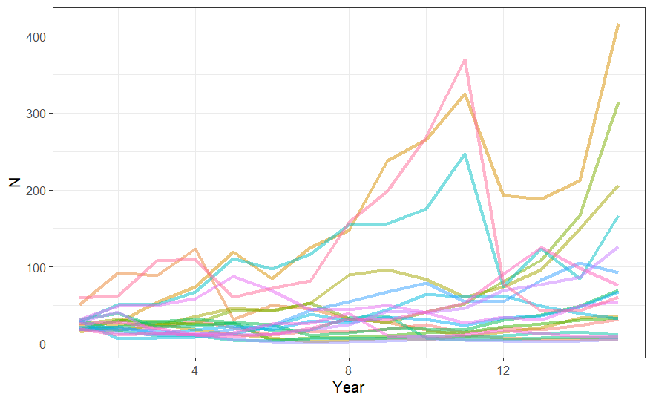
Normal conditions
High standard deviation
Low lambda
Low starting population
Notes:
What makes populations vulnerable to stochastic extinction?
First, clarify the meaning of this term
Low lambda values
High standard deviation
Low population sizes

Slide 6
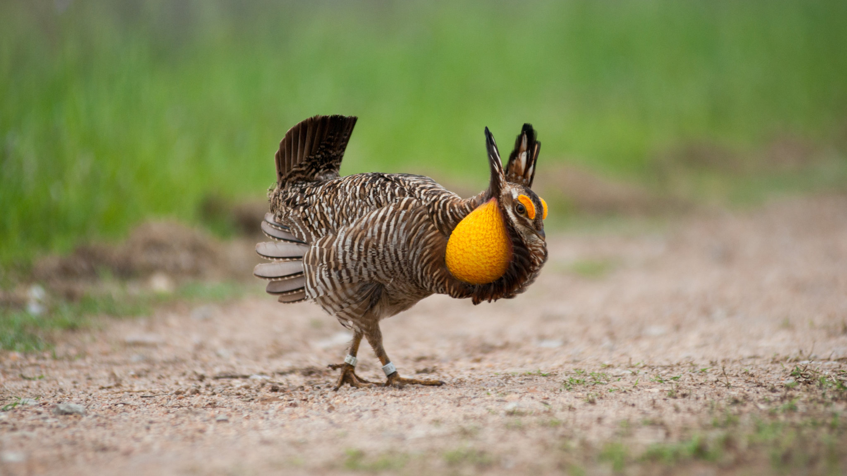
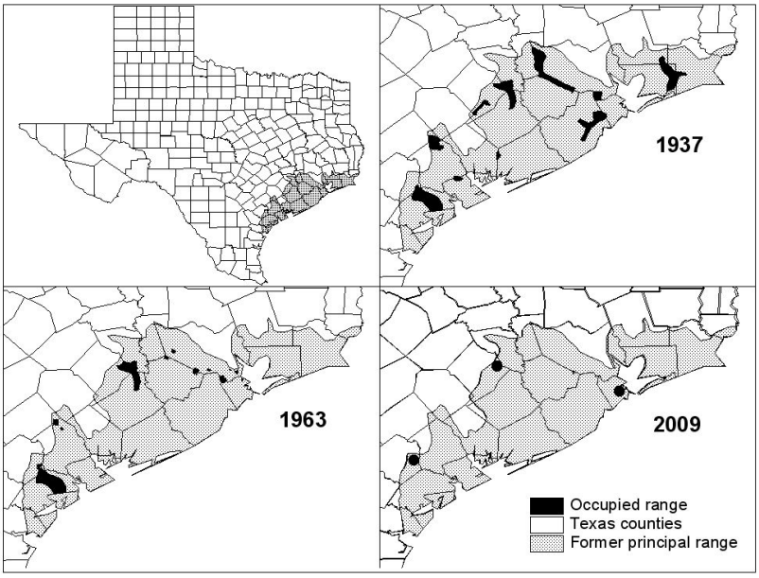
Attwater’s prairie-chicken
(Tympanuchus cupido attwateri)
Notes:
Real world examples
Attwater’s prairie-chickens
Heavy spring flooding
Hurricanes

Slide 7


Arctic Tern
(Sterna paradisaea)
Notes:
Arctic terns

Slide 8
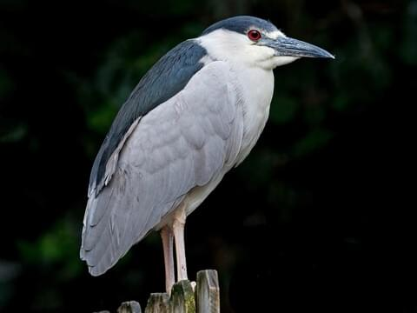
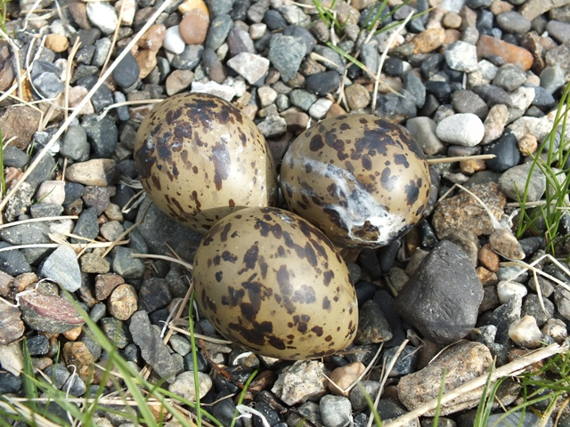
Black-crowned Night-Heron
(Nycticorax nycticorax)
Notes:
Arctic terns
A single Night Heron can wipe out a full year’s nest productivity

Slide 9
How do we manage to avoid stochastic extinction of populations?
Keep lambda high
Habitat quality, predator management, etc.
Maintain high population sizes
Allow immigration to reestablish populations
Population connectivity

Slide 10
